Slide 1


eSUM: European Safer Urban Motorcycling Project
Road Safety Seminar, Cyprus
Andy Mayo
Director
Local Transport Projects Ltd.
30 November 2011

Slide 2
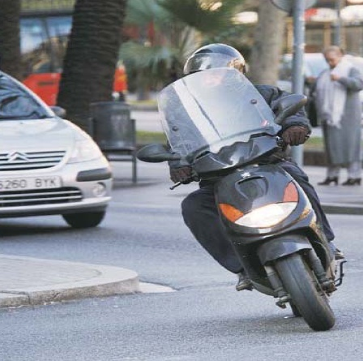
Presentation summary
Context
Consortium & project objectives
Diagnosis
Demonstrations
Main deliverables
  Good Practice Guide
  Action Pack
Notes:
Good morning ladies and gentlemen, my name is Andy Mayo, I am a director at Local Transport Projects Ltd which is a specialist road safety consultancy based in Yorkshire, England. We have been working on behalf of Transport for London for the last 3 years on the eSUM (or ‘European Safer Urban Motorcycling’) project. I am delighted to be given the opportunity to visit your beautiful country to present the project to you on behalf of Transport for London.
First a brief introduction - my career spans over 20 years in the field of road safety and I have worked in various local authorities before forming my company with a colleague in 2004. I have a passion for helping to reduce the needless waste of life on the roads, but am also a keen motorcyclist. I have been riding motorcycles since the age of 6, racing, commuting to work, touring, and just riding for fun. eSUM has enabled me to combine my professional road safety experience with my practical motorcycling knowledge, and I have thoroughly enjoyed working on the project. eSUM brought together a number of cities and other partners with the common goal of collecting best practice gained from around the world and using this to help reduce injuries to motorcyclists. It also developed an “Action Pack” for others to follow in order to develop a plan to improve motorcycle safety in their own area, based on best practice. It is our aim now to disseminate what we have learned, and to encourage other authorities to also develop an “Action Pack” using the eSUM work as a base, to take forward the planning of initiatives to help further improve motorcycle safety.
I will start by giving you some background information on eSUM and then running through the objectives of the project and also the main results.

Slide 3
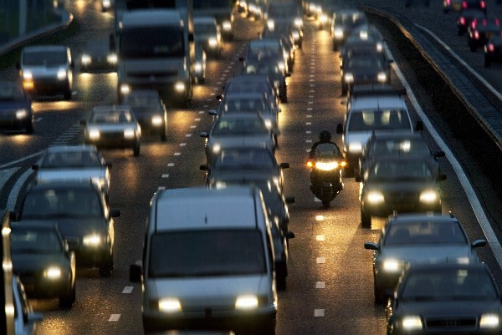
1. Context - Growing mobility needs, urban challenges
Notes:
More than 70% of the EU population lives in urban areas. As city dwellers are estimated to grow to 80% of the total European population by 2020, urban traffic is going to be put under severe strain.
Urban areas face today the challenge of making transport sustainable, this means making mobility more environmentally friendly, reducing congestion and improving road safety. Solutions are needed to address health problems and demographic trends, fostering economic and social cohesion as well as taking into account every transport mode whilst also providing freedom for people to choose how to travel in their city.
Urban mobility is of growing concern and 9 out of ten EU citizens believe that the traffic situation in their area should be improved.

Slide 4
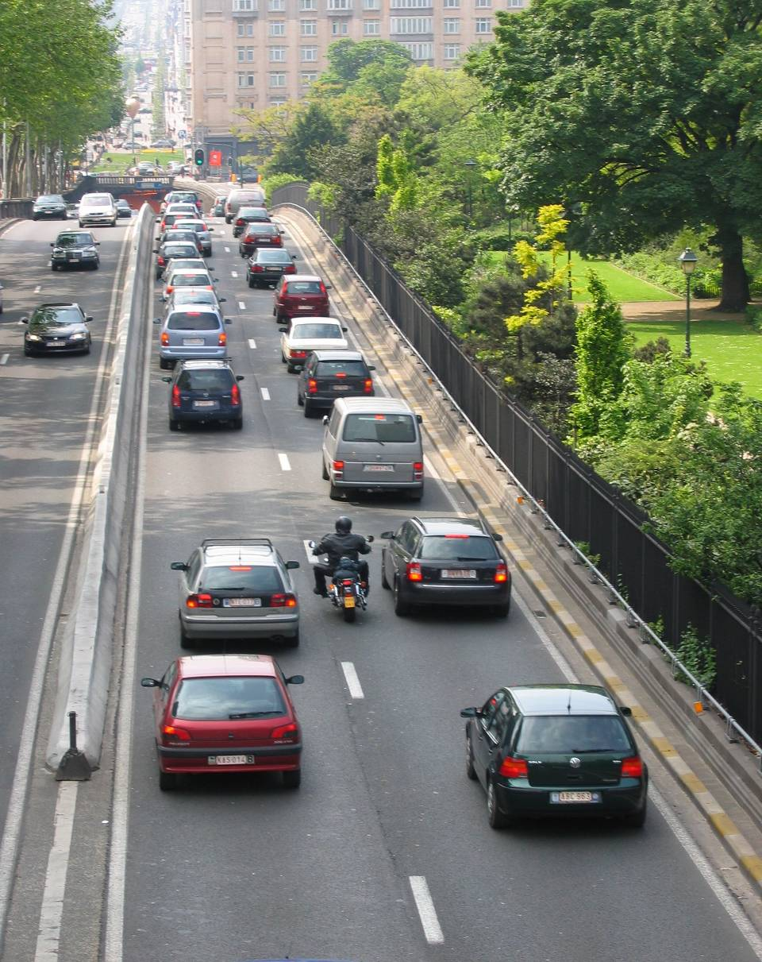
1. Context – increasing PTW use in respond to mobility demands
Continuous increase of PTW fleet pushed by urban mobility needs
Notes:
4
PTWs are one of the answers to this growing mobility need. People are increasingly using PTWs because of their convenience and advantages in terms of door to door mobility, flexibility, parking, costs and fuel consumption. In recent years cities have experienced a tremendous growth in PTW use with increases of up to 400% in cities such as Rome and Barcelona.

Slide 5

EU current objective & performance
Notes:
Good progress has been made in reducing the number of casualties of all types in Europe.
This is against a background of large increases in the number of PTWs on the roads shown in the earlier slide.
However, the EU objective to save 25,000 lives between 2000 and 2010 is a challenging target, and more effort needs to be made, particularly in the area of PTW crashes.
Forecasts show continued growth in the PTW market, particularly in the scooter sector where a 43% increase is projected over the next 10 years. This is perhaps a reflection of the increasingly congested nature of many of our towns and cities. People are increasingly seeing scooters as a quick and easy way to beat congestion. The capacity of the road network is difficult (if not impossible) to increase in most urban areas. However, a switch from cars to motorcycles and scooters increases the number of people the system is able to move.

Slide 6
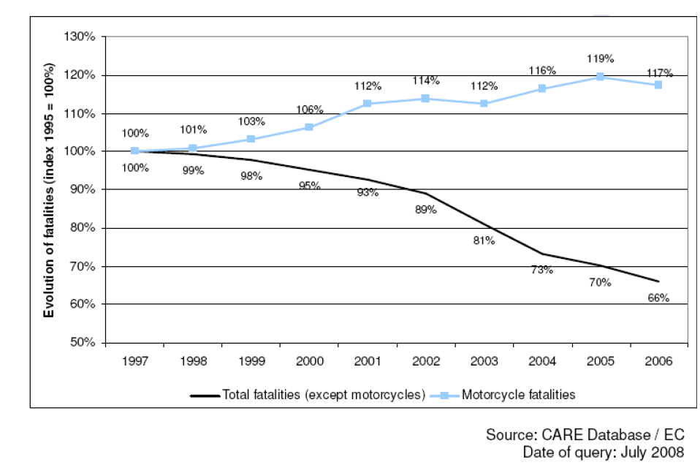
Motorcycles – room for improvement
Notes:
You can see here, the level of motorcycle casualties has remained stubbornly high over recent years, in contrast to the overall casualty figures which have shown good reductions.

Slide 7








2. Consortium & Project Objectives
Cities
National authorities
European Commission
Manufacturers
Researchers
Notes:
So where does eSUM fit in and how can it help to reduce the number of people injured in PTW crashes?
eSUM is a collaborative initiative between, local authorities of the principal European motorcycling cities, universities and the motorcycle industry, to identify, develop, demonstrate and promote the wider uptake of measures that are effective in improving the safety of urban motorcycling. You can see all the project partners listed in the slide above (I hope I haven’t missed any out!) It is supported by the European Commission and its important to note that it is primarily focused on the URBAN situation, given the large increase in PTW use seen in many European cities and the projected increases seen earlier. The main cities involved are Barcelona, London, Paris and Rome, which are those cities in Europe with the largest numbers of PTW riders. These cities have also been at the forefront of developing initiatives to reduce PTW casualties in urban areas in recent years and so were well placed to lead on the project.

Slide 8
2. Consortium & Project Objectives
Identify, Develop and Demonstrate measures designed to deliver safer urban motorcycling, in the short, medium and long term
Using an integrated approach, contribute to a steady decline in PTW user casualties in EU accident trends:
  Improved diagnosis
  Identification of demonstrated good practice
  Apply good practice in urban PTW Action Plans
  Demonstrate Advances in the State-of-the-art
  Promotion of rapid adoption of good practice.
eSUM approach:
Diagnosis -> Good Practice -> Demonstration -> Evaluation -> Transfer -> Dissemination
Notes:
The eSUM project identifies, develops and demonstrates actions for delivering safer motorcycling in the city environment. The goal of the project is to reduce the number of accidents involving powered two-wheeler riders, by addressing the behaviour of riders, the vehicle design and the infrastructure. The characteristics of accidents, infrastructure trials and vehicles with enhanced safety features as well as various awareness raising campaigns and training programmes were also examined. Using the conclusions of this analysis, guidelines and good practices were developed and have now been made available to other cities aiming to adopt effective measures to improve PTW safety.
The basic objective of eSUM is to identify all of the various elements of work that are being carried out throughout Europe (and indeed the rest of the world) to improve motorcycle safety. From this, we have then identified those that have been the most effective and are now highlighting these to road safety practitioners, manufacturers, other municipalities and so on, to promote a rapid adoption of best practice throughout Europe.
There was previously no single place where people that are working to improve PTW safety can go to find out what works and what doesn’t. eSUM provides that resource.

Slide 9
3. Diagnosis - Benchmarking urban PTW accidents
Notes:
The first task was to carry out benchmarking between data on PTW accidents in Barcelona, Rome, Paris
and London. A lot of data was assembled and explored such as: population, area, road
network length, number of killed and injured people, etc. This highlighted a number of
differences between the cities in the data which is collected, and how it is collected.
eSUM also looked at relevant traffic management & PTW road safety actions and an
overview of mobility trends and overall road safety levels in each city.

Slide 10
Benchmarking urban PTW accidents
Notes:
OK, the number of PTWs, PTW share in the motor vehicle fleet, PTW fatalities per milion inhabitants and so on.

Slide 11
Benchmarking urban PTW accidents
Notes:
Some of the key trends: In London the PTW fleet and the number of killed riders have remained stable with a slight
increase in fatalities in 2008.
Paris has made a significant reduction in the number of killed riders – from 40 to 15 with a
Substantial increase in the size of the fleet at the same time.
Barcelona stabilised the number of PTW fatalities in spite of increased PTW usage.
In the last few years a reduction of the PTW fatalities has been registered.
Despite the impressive PTW fleet increase Rome has managed to reduce the number of PTW
fatalities and injured riders in 2005 and since then the numbers have been kept stable
notwithstanding the continuous increase of the PTW fleet.
The above figures do, however, show the wide variation in circumstances between the 4 partner
cities and highlight the importance of accounting for the local situation when attempting to apply
actions to reduce injuries to PTW riders.

Slide 12
Current Knowledge - Urban PTW Safety
Main findings – MAIDS Urban Accident Report
A failure by the other vehicle driver – primary cause for urban accidents (perception or decision failure)
Environmental factors - more important role in urban context
Riders involved in urban accidents - less trained and less skilled than the total number of MAIDS riders
Fatal and single accidents - less commuting pattern, evening and night hours, caused by a PTW rider failure.
Notes:
As part of the ‘Diagnosis’ stage, the MAIDS Accident study was examined in detail using the urban sub-database collected during the main MAIDS project
The report looked at:
The general characteristics of 666 urban accidents investigated in depth
Urban accident causation factors
Time of urban accidents
Location (road type, alignment, surface, intersection type, traffic control signs, view obstructions)
People involved (age, gender, license, training, experience)
Vehicles involved (PTW style, engine capacity, other vehicle classification)
PTW rider injuries (by severity and body part, collision contact code)
Single vehicle urban accidents (type of area, PTW legal category, number of fatalities, time of accident, day of week)
Fatal urban accidents (type of area, primary contributing factor, PTW legal category, time of accident, day of week)
The MAIDS study confirmed that the major cause of accidents was due to a human error committed mainly by other vehicle drivers, although the environmental factor was found to be of bigger relevance in the urban accident causation, especially when view obstructions along both rider’s and other vehicle driver’s line of sight were present, and roadway surface was affected by maintenance defects.
PTW riders involved in urban accidents were found to be less trained and skilled than other riders, having less official training and more control unfamiliarity and skill deficiencies.
A different pattern was found when single and fatal urban accidents were analyzed separately. These accidents showed to be less commuting related and more connected to some recreational activities: they occurred more during the evening and night hours and PTW riders were more prone to take risks, such as speeding over the posted speed limit, wearing helmets improperly or being alcohol impaired.

Slide 13
4. Demonstrations
 | Number of demonstration actions
Infrastructure | 9
Enforcement | 4
Vehicles / features | 5
Rider training / Driver awareness | 4
Total | 22
Notes:
A number of Demonstrations were also developed and the eSUM project was an
opportunity to test and validate new concepts, to promote proven best practice,
and to extend the state of the art. It also provided an opportunity to transfer and
encourage the wider uptake of good practice.
So there were 22 demonstrations in total, split up as shown above.

Slide 14
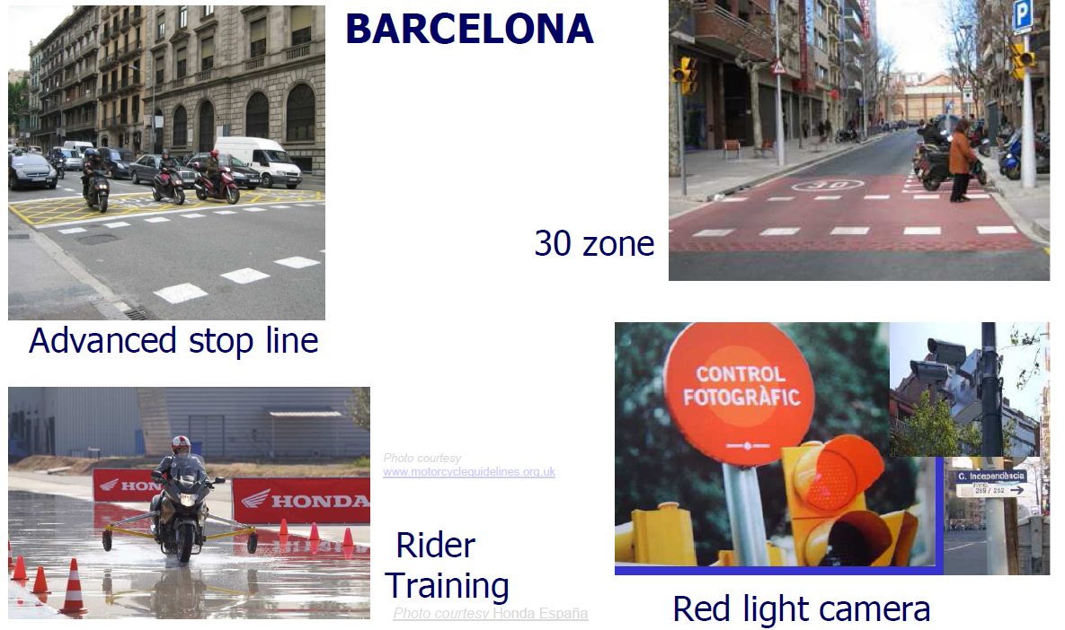
Demonstrations
Notes:
So some of the Barcelona Demonstrations:
Advanced Stop Lines specifically for PTWs (given the very high number of bikes in Barcelona).
Rider training, 30kph speed limit zones and red light enforcement cameras.

Slide 15
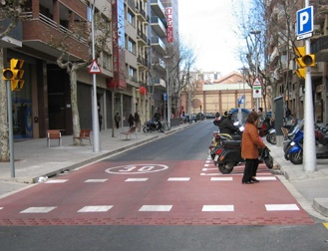
Infrastructure - 30 Zones
30 Zones implementation (speed limit of 30 km/h) in Barcelona
positive effect on the accidents trend
from +1.3% annual increase casualties to 12.2% reduction
the average monthly PTW casualties – reduced by 40.5% (five years prior to implementation)
Notes:
30 Zones implementation (speed limit of 30 km/h) in Barcelona has been analysed and shown to have had a positive effect on the trend in accidents of the treated areas (from a +1.3% annual increase in casualties prior to implementation to a 12.2% reduction afterwards), In 2009, the average monthly number of PTW casualties has reduced by 40.5%, compared to the figures of the five years prior to implementation), within the 30kmh zones.

Slide 16
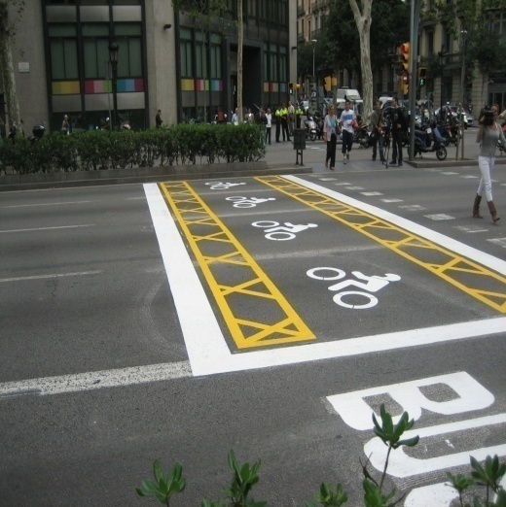
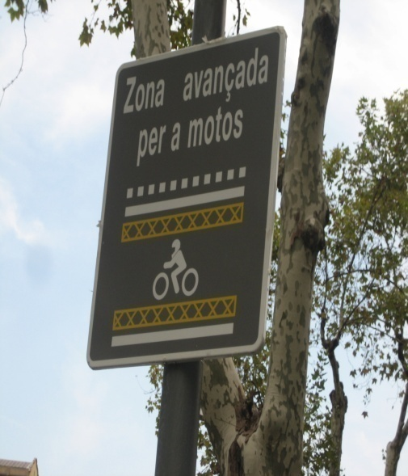
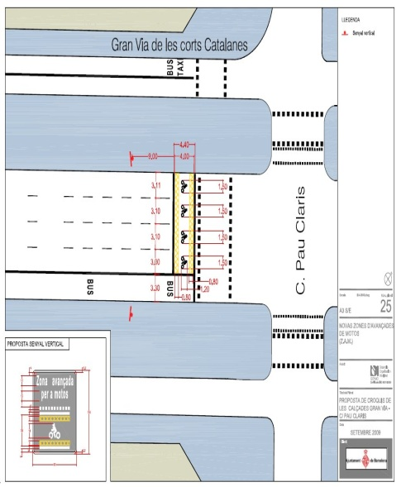
Infrastructure - Advanced Stop Lines
Barcelona: 3 junctions in 2008:
large reduction in movements involving risk – from 29 to 8%
ASL - introduced in 36 sites in 2009.

Slide 17
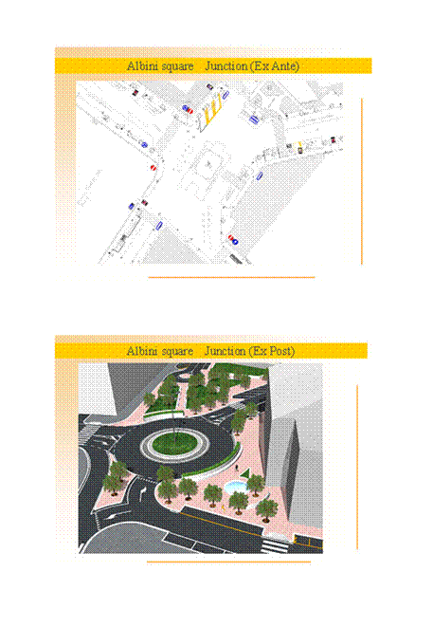
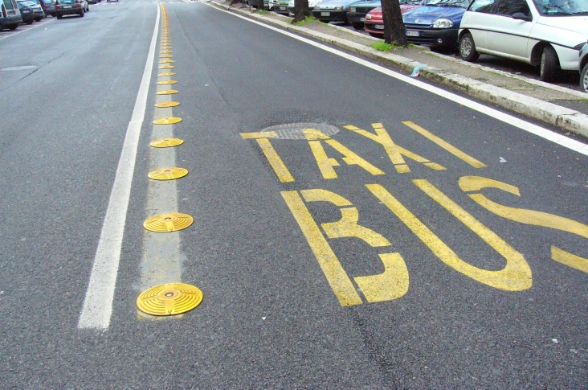
Infrastructure - Improving the safety of circulating PTWs
ROME
New highly visible discs Black spot remedial actions
Notes:
So examples of the Demonstration projects in Rome:
Removing bus lane separators: The removal of high kerbs that physically separated bus lanes from other traffic has been carried out for 35kms of the Rome road network. During the 4-years period prior to this intervention there were 6 fatal accidents involving PTW casualties hitting the kerbs compared to no reported accidents for the first year post–implementation. Cars are prevented from changing lanes, while the discs present much less of a risk for motorcycle riders.
A number of PTW collision black spots have also been identified and treated in Rome, for example, implementing roundabout designs to replace signalled junction “black spots”. This site at Oberto-Rizzieri has shown a reduction in total accidents from 12 in 2004 to 1 in 2008;

Slide 18
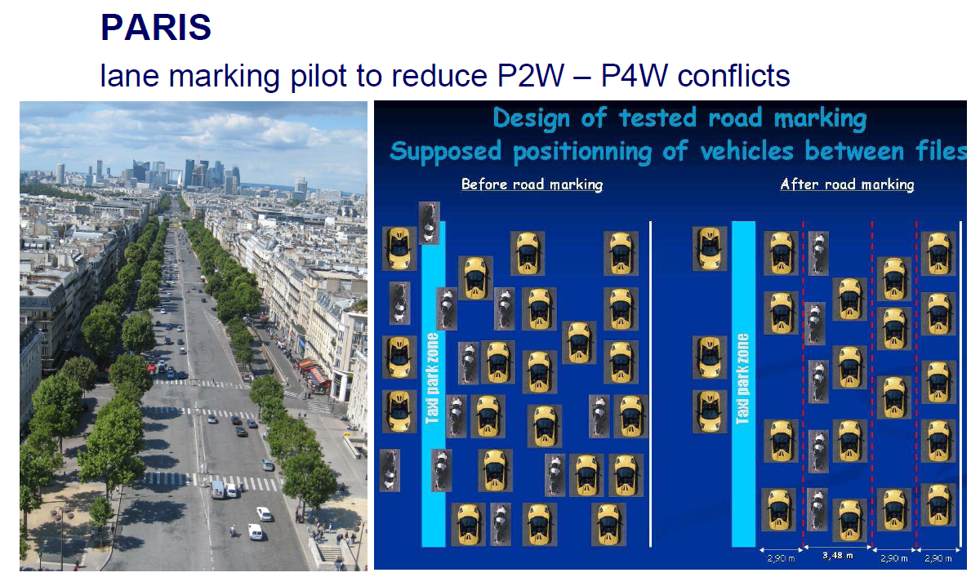
Demonstrations
Notes:
An example of a project in Paris is the study of PTW use of bus lanes. There are 189km of bus lanes in Paris, even though it is not allowed in Paris, 54% of accidents in bus lanes involve PTW riders (8% of road accidents of all types involved a PTW rider using a bus lane). According to the analysis work carried out by Paris as part of the eSUM project, there is no evidence that allowing motorcycles to use bus lanes would lead to improvement of the PTW safety.
There was also a project carried out to re-design road marking layouts on some of the major boulevards, to address PTW collision problems.

Slide 19
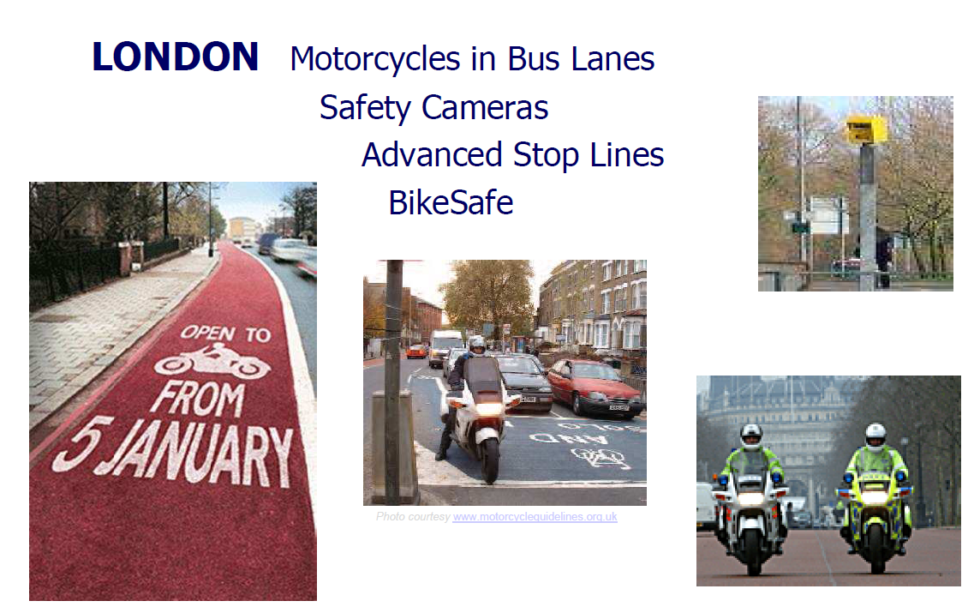
Demonstrations
PTW Route Studies
Notes:
In London there were trials permitting motorcycles into bus lanes, analysis of the role of safety cameras in reducing PTW casualties, Advanced Stop Line studies, Rider Training initiatives (Bikesafe), and studies of the routes in London with the highest rates of PTW collisions.

Slide 20
Infrastructure: PTWs in Bus Lanes
London - opening 107 km bus lanes to PTWs
51% PTW switched to the bus lanes
33% increase of collisions on 28 survey sites where PTWs were permitted to use bus lanes
the ‘before’ and ‘after’ figures for 28 Control sites - decrease of 50.7% for PTW collisions
a focussed safety campaign was undertaken (18 month trial)
Results due to be announced December 2011.
Notes:
The opening of 107 km of bus lanes to London’s PTW users occurred in January 2009, and was evaluated
as part of the eSUM demonstration. Journeys made by motorcycles using bus lanes were more than
10% quicker than those not using bus lanes. However, the report identified an increase in motorcyclist
collisions, predominantly with cars turning into or out of side roads on routes where motorcyclists
had access to bus lanes. This fact is understandable, because of the increase of the traffic in the bus
lanes and migration of PTW riders. For comparison purposes. the ‘before’ and ‘after’ figures for the
28 Control sites showed a decrease of 50.7% for PTW collisions.
In deciding to grant a second 18-month trial allowing PTW use of bus lanes, TfL also implemented
an awareness campaign aimed at improving drivers' awareness of motorbikes and cyclists in bus
lanes, and for motorcyclist using bus lanes to reduce their speed. The results of this extended trial,
and a decision on whether or not the arrangements to allow motorcycles permanent access to bus
lanes, are due to be announced very shortly.
The first trial enabled us to understand what was going on.
The second trial attempted to address the problems through mitigating actions

Slide 21
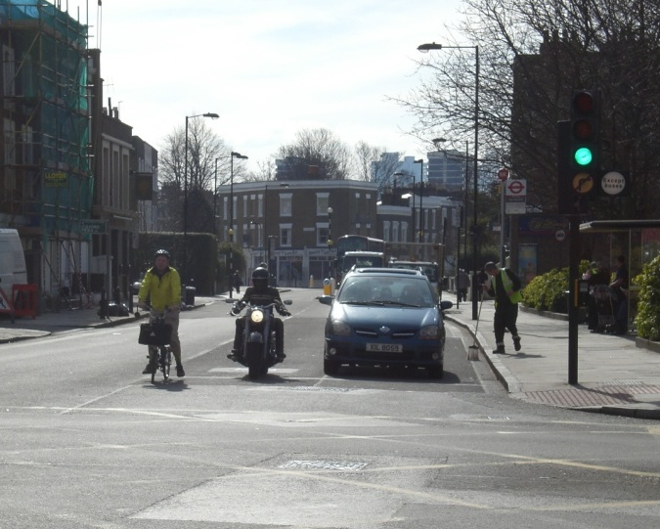
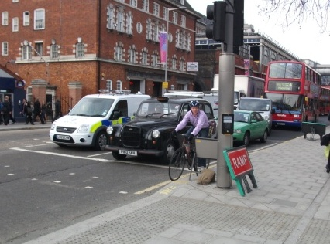
Infrastructure - Advanced Stop Lines
London – Advanced Stop Lines
London demo - ASLs already installed for pedal cyclists
investigation to resolve potential conflicts between different 2 wheeler groups
no significant change in PTW behaviour or collision expected by allowing them to use ASLs.
Notes:
Using the favourable initial results from Barcelona where 36 PTW advanced stop lines are now
implemented, Transport for London used video coverage and collision data to assess the use
of existing ASLs installed for pedal cyclists, to see if there might be an advantage in allowing
PTWs to use them. The analysis of collision data found no difference in the level of conflicts
between PTWs and cyclists at site with or without ASLs. A high level of encroachment of PTWs
into the ASL area was found. It was concluded that it is unlikely that there would be any
significant reduction in PTW collisions resulting from legislation allowing the use of ASLs by PTWs.

Slide 22
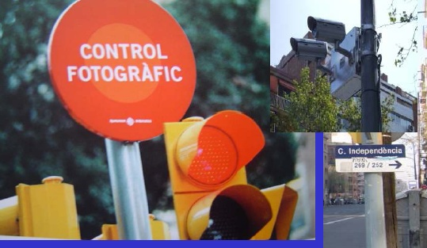
Enforcement - Safety Cameras
London - retrospective analysis, impact of safety cameras on PTW collisions at 397 sites (28 red-light, 369 speed camera), data 2002 to 2007. Results - annual reduction of 30% in PTW collisions.
Notes:
Transport for London also retrospectively analysed the impact of safety cameras on PTW collisions at 397 sites
(28 red-light and 369 speed cameras) based on collision data between 2002 and 2007.
The results showed an annual reduction of 30% in PTW collisions at the camera sites.
There was also a transfer of this best practice, with Rome subsequently implementing
10 camera sites and Barcelona 36.

Slide 23

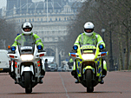

Rider training / Driver awareness
900 high school students in PTW safety campaign in Rome
Employer-based promotion of rider training programmes in London (Bike Safe) and Barcelona - hundreds of riders trained
Dissemination of Paris Road Safety Charter
Protective equipment for riders’ campaign
English, French, German, Italian, Spanish, Swedish, Dutch, Greek –
Notes:
I know this is of particular interest to Cyprus.
eSUM analyzed hundreds of rides who had been trained via Employer-based programmes in
London & Barcelona, and improved the feedback process to better evaluate the
impact of the training. London also further developed the successful Bikesafe rider training
programme, particularly looking to “customise” it for TfL employees with a view to offering
such training to other large employers active in developing mobility plans. Providing free,
secure parking at workplaces to those PTW users who have completed rider training is seen
as being an effective way of encouraging PTW users to participate in training courses.
100 employees from Barcelona Municipality participated in the rider training during
May-June of 2010 and the questionnaire from London Bike Safe was used to explore the
trainees attitude and safety perceptions. In Rome, during Spring 2009, some 900 school
pupils at the age of 14 to 19 participated in various events aiming at raising safety
awareness and changing behavior. Video materials were used, and some 600 questionnaires
regarding participants’ feedback were analyzed. With all of the Demonstrations we have
been careful to ensure that there is a robust evaluation of the results carried out.

Slide 24
Good Practice Guide
5. Good Practice Guide
‘Identifying Good Practice to reduce PTW casualties in urban areas’
Notes:
Transport for London were responsible for developing the Good Practice Guide, so I’ll talk about this in a little more detail. I’ll give a brief introduction to the Good Practice Guide, a quick review of the methodology we used to identify Good Practice, I’ll talk about the final outputs, and how this work will help everyone who has a stake in helping to improve safety for motorcyclists in urban areas throughout Europe.
The key aim of the Good Practice Guide was to identify all of the different initiatives which have been developed throughout Europe and further afield in order to reduce PTW casualties.
Much work has been carried out in the area of PTW safety, but there is a need to highlight those projects that have been proven to work and those that have not. A summary of all most effective initiatives will then provide a single resource or “one stop shop” for those people working in the field of road safety throughout Europe. Previously there was no one place that practitioners could go, whether they were road safety engineers in municipalities, police officers, manufacturers, researchers etc., to find out what really is successful and is backed up by thorough monitoring. This is made more difficult by the multitude of initiatives which just “seem like a good idea” but which may have no real monitoring of scientific data behind them.

Slide 25
1
WP2
Benchmarking
2
WP2
Conclusions
3
WP2
Recommendation 1
4
WP2
Recommendation 2
5
WP5
Monitoring, evaluation, synthesis –
Part 1 Establish common criteria
6
WP3
GP Guide
7
WP4
Demonstrations
8
WP5
Monitoring, evaluation, synthesis –
Part 2 apply common criteria
10
WP7 Dissemination
9
WP6
END PRODUCT
ACTION PACK FOR FOLLOWER CITIES
Notes:
The Good Practice Guide forms an important part of the “Action Pack” that eSUM has developed for other cities to use as a starting point to develop their own programme of effective measures to reduce PTW collisions. This shows the overall framework of the eSUM project, and where the Good Practice Guide fits in.

Slide 26
Good Practice Guide
Identifying Good Practice to reduce PTW casualties in urban areas
Detailed web searches
Research and academic institutions
Questionnaire widely distributed
Over 200 projects assessed
Priority given to projects where robust monitoring data was collected
GPG contains 120 examples
Essential part of eSUM Action Pack
Guide to form an ongoing resource.
Notes:
So this work focused on identifying existing good practice in urban PTW casualty reduction. The key output is the creation of a unique web-based guide for road safety practitioners, providing guidance on good practice projects from across the world . Emphasis was placed throughout on those interventions which demonstrate casualty reduction through a robust evaluation process. A standard assessment form was used for each project, allowing transparency when considering the relative merits.
From the outset we felt it was important to look for examples from around the world, and we have found some excellent projects from he United States, Australia and south east Asia as well as many from throughout Europe.
We were looking for assessment based on casualty data or generic research
Priority on data-led projects and those related to eSUM objectives (in the medium 5 year term)
Need to consider cultural & structural differences between partner nations –
A good example of the cultural / structural difference is the issue of protective clothing in cold vs warm climates.
We then rated the projects as Red (Potential as Good Practice in Next 5 Years), green (yes - recommend as Good Practice) and blue, (emerging technology with good potential ),
For example, there are some promising laser based systems being developed which monitor road surface conditions and can alert the rider to any problems. So far there is little hard data on the effectiveness of such a system in reducing accidents but we know that skidding and loss of control feature highly in PTW accidents. A measure which addresses one of the primary causation factors in this type of collision has a good chance or reducing such collisions, hence this was rated as a positive emerging technology.

Slide 27
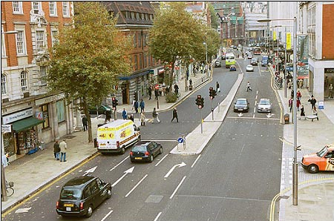
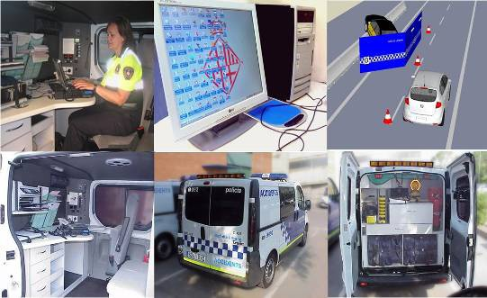
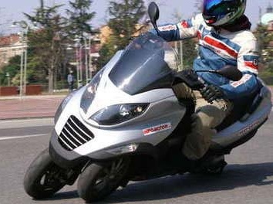
6 Key Areas to identify Good Practice:
Good Practice Guide
  BP1 Rider training and awareness campaigns
  BP2 Highway features and policy
  BP3 Effectiveness of targeted enforcement.
  BP4 Specific remedial measures at ‘black spots’
  BP5 Improved PTW design
  BP6 Potential for ‘soft’ street furniture to reduce PTW
  injuries.
Notes:
The GPG has been updated every 6 months in the frame of the project. Consideration has been given to sustaining the GPG beyond the life of eSUM and TfL has committed to an on-going review process post project completion.

Slide 28
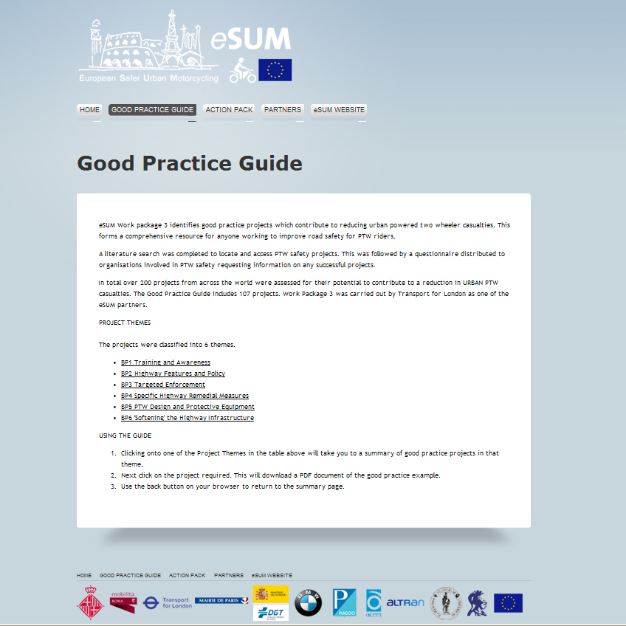
Good Practice Guide
http://www.esum.eu/gpg.html
Notes:
28

Slide 29

Examples from GPG
BP1 001: BikeSafe / ScooterSafe London (2003).
  Around 20,000 riders completed training
  London PTW casualties reduced by 39%
Notes:
29

Slide 30
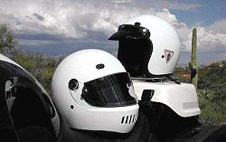
Examples from GPG
BP1 005: Effect of campaign to support Italy’s motorcycle helmet law (2000).
  Correct Use of Helmet up from 19.5% to 97.5%
  PTW traumatic brain injury admissions cut by @70%
Notes:
30

Slide 31

Examples from GPG
BP2 017: Strategic Plan for the Road Safety of Motorcycles and Mopeds, DGT Spain (2007).
  Introduced to reverse the rising trend in PTW deaths and serious injuries
  Number of PTW KSI reduced by 26% 2007-09
Notes:
31

Slide 32
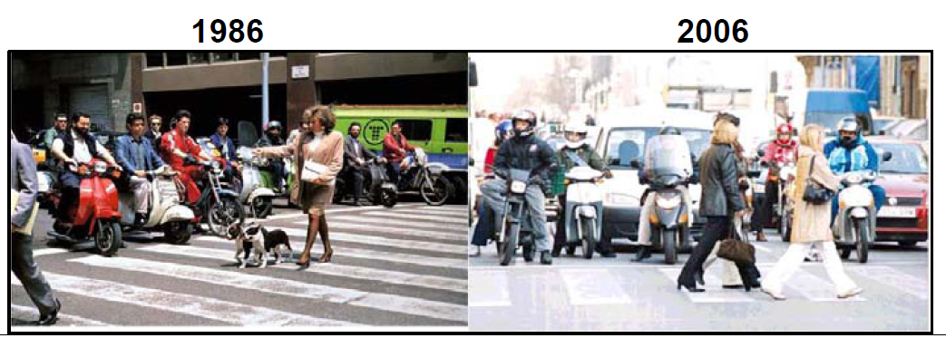
Examples from GPG
BP3 011: Change in Helmet Law in Barcelona (1992).
  Targeted enforcement on helmet offences
  Correct Use of Helmet up from 36% to 91%
  Fatalities reduced by 35%
  Serious head injury reduced by 41%
Notes:
32

Slide 33

Examples from GPG
BP4 001: Victoria Motorcycle Blackspot Program.
  Funded in part by the Motorcycle Safety Levy applied to all PTWs above 126cc
  Targets locations with high numbers of PTW collisions
  Reduction in PTW collisions of 38% at first 51 sites
Notes:
33

Slide 34
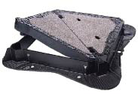
Examples from GPG
BP4 002: Skid Resistant Safer Inspection Covers.
  High friction surfacing for metal access covers
  Improved skid resistance value
  Loss of control on poor surface is highlighted in the MAIDS and DfT studies and is a frequent PTW hazard.
Notes:
34

Slide 35
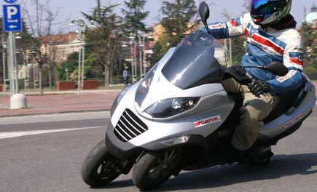
Examples from GPG
BP5 015: Piaggio MP3.
  3 wheeled scooter
  Provides 33% more contact area
  Claimed 24% reduction in braking distance in wet
  The MP3 offers a counter measure to PTW collisions involving loss of control.
Notes:
35

Slide 36
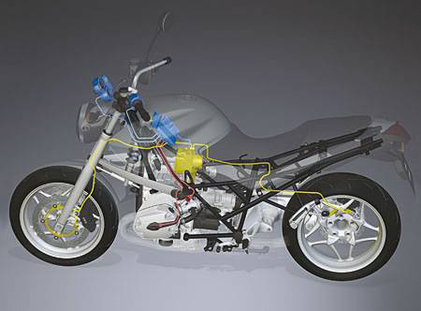
Examples from GPG
BP5 004: Advanced Braking Systems.
  Anti-lock and linked braking systems
  Significantly improved emergency braking and retention of control
Notes:
36

Slide 37

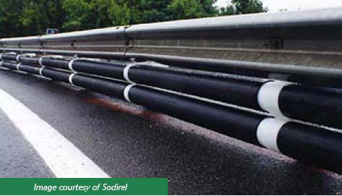
Examples from GPG
BP6 004: Motorcycle Friendly Crash Barriers.
  Crash barriers providing under-run prevention for PTWs
  Effects greatest on rural routes.
Notes:
37
This was the most difficult category as there were very few examples,
at least in the urban setting.

Slide 38
5. Main deliverables - Action Pack
ACTION PACK
An easy-to-use ‘Toolkit’
to be used independently by road safety practitioners
to identify the actions required to analyse PTW safety issues
to decide upon suitable safety interventions and formulation of PTW urban road safety action plan.
http://www.esum.eu/actionpack.html
Notes:
Another key output was the PTW ‘Action Pack’. This is intended to provide an easy-to-use template to help towns and cities develop and implement their own PTW road safety programmes. It uses the lessons learnt by Barcelona, London, Paris and Rome, through the eSUM project, and demonstrates how to develop and implement effective counter-measures to common PTW collision types.
The eSUM Action Pack is a guide to help politicians and municipal technicians responsible for road safety to organise their work for promoting Powered Two Wheeler (PTW) urban road safety. The document provides guidance to assist those municipalities interested in learning from eSUM when developing their own PTW Road Safety Action Plans.

Slide 39
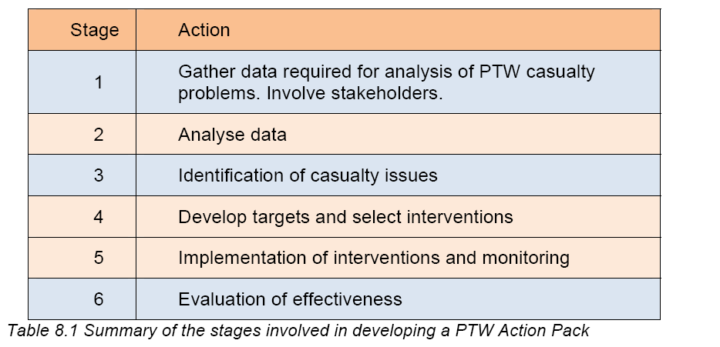
Action Pack
Available in: English, Spanish, Italian, German, French and Greek on DG MOVE website
Notes:
There are 6 key stages to this process as we can see on the slide.
London is currently developing its own motorcycle road safety plan, based on the toolkit.
Translations for the Action Pack and Good Practice Guide will be available on the eSUM website in February 2012.
The eSUM Project provides immediately applicable tools and methods to improve the safety of traffic in European cities and towns. The “Action Pack” and the “Good Practice Guide” as well as other project examples can be found on the website www.esum.eu
eSUM has shown that there is a lot of good work that has been done, and that is currently being carried out, to improve motorcycle safety. I hope that the Action Pack will encourage other cities to develop their own plan so we can all work together to ensure that as well as being one of the most fun and convenient ways of travelling, motorcycles can also become a safer way of getting around.

Slide 40
European Safer Urban Motorcyling (eSUM)
For more information: www.esum.eu
Thank you for your attention!
Andy Mayo
Local Transport Projects Ltd.
andy.mayo@local-transport-projects.co.uk
or: tom.duckham@tfl.gov.uk

